Slide 1
Remote Terminal Manager
Monitor and control your BGAN

Slide 2
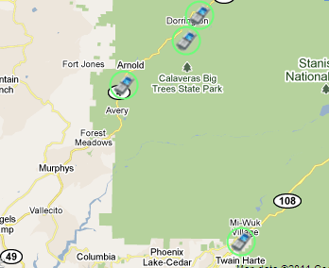

What is Remote Terminal Manager?
A web-based service to monitor, control and update and configure your BGAN terminals
  Combines Terminal Remote Control functions with Dashboard/POP status information
  View and control the state of a terminal’s IP or streaming session
  Receive notifications when a terminal creates or disconnects an IP session
  Determine the BGAN’s Position and view it on a map
  Retrieve diagnostic report information from the
  terminal
  Update firmware and reboot the terminal
  Send text messages
  Note: Available functions depend on terminal type

Slide 3
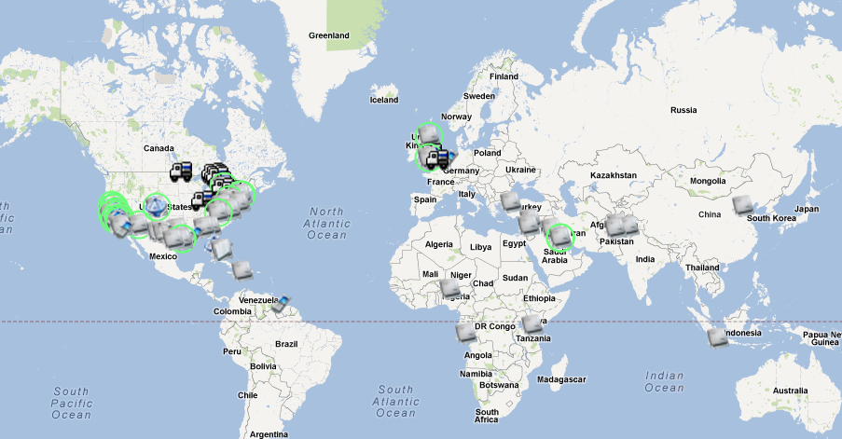
Why using Remote Terminal Manager?
Ensure that always-on terminals stay on: alerts of status changes of data connection
Secure SMS based access to terminal for configuration.
Remote access to the unmanned BGAN equipment
Reducing costly field visits to remote terminals
Retrieve information from the
terminal that is not available via
other means
Enhances support levels and
reduces support times, as support
centers are no longer dependant on
feedback from the terminal location
to troubleshoot

Slide 4
Remote Control support per Terminal type
 |  | Network Information | Connection Status Alerts | Send SMS | Data Connection Control | Advanced Data Connection Control | Terminal Status and Information | Remote Terminal Control | Geo- position and Mapping services
Manufacturer | Terminal(s) | Basic |  |  | Remote Control
HNS | 9201*, 9202*, 9450* | √ | √ | √ | √ | √ | √ | √ | √
 | 9250, 9350 | √ | √ | √
 | 9502 | √ | √ | √ | √ | √ | √ | √ | √
Thrane & Thrane | Explorer 100/110 | √ | √ | √
 | Explorer 300, 500, 700 | √ | √ | √ | √ | √
 | Explorer 325, 527, 727 | √ | √ | √ | √ | √
Addvalue | Sabre 1 Remote | √ | √ | √ | √ | √ | √
 | Sabre 1 | √ | √ | √
 | Sabre Ranger | √ | √ | √ | √ | √
Notes:
*Remote control functions to be activated by an activation code from HNS
** Network and Connect status available when the APNs of the legacy Stratos network are used.

Slide 5
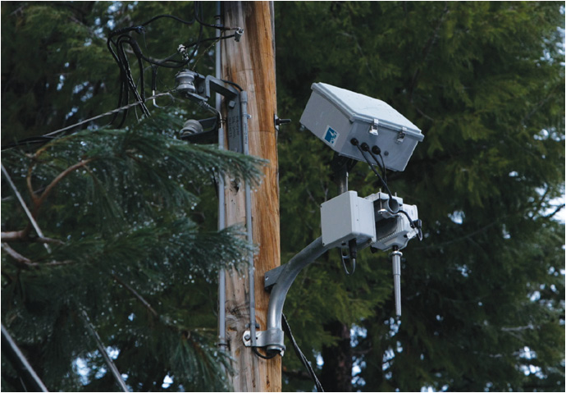
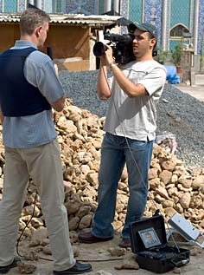
The Remote Terminal Manager Market
Media
    Asset and personnel tracking (GPS)
    Notification or alert of changes in connection
    Remote connection control
Scada, Utilities. M2M
    Connection monitoring. Remote support/upgrades
Mining
    Connection monitoring
    Vehicle tracking
Transport
    Connection monitoring. Remote support/upgrades
    Asset and personnel tracking. Activity notification
Carriers/network service providers
    Scada/M2M Network Control Service providers

Slide 6

How to order?
Remote Terminal Manager subscriptions can
be ordered via Dashboard as Value Added
subscription on a SIM
Access to the Remote Terminal Manager
web application managed via
Gateway User Management
For test and demonstration options please contact Sales representative.

